Slide 1
Forecasting covid-19 cases and Deaths
CDA 571 Summer Data Challenge
Team: Alpha Cluster

Slide 2
Table of contents
Introduction
Motivation
Dataset and it’s Key Metrics
Exploratory Data Analysis
Model Choices
Dashboard Summary
Roles and Responsibilities
Challenges
Prospects

Slide 3


Introduction
Coronavirus disease 2019 (COVID-19) is a contagious disease caused by the coronavirus 2, which causes severe acute respiratory syndrome (SARS-CoV-2)
In December of 2019, the first known case was discovered in Wuhan, China. Since then, the disease has spread around the world, resulting in the current COVID-19 pandemic
In this project we’ve chosen the centralized repository of up-to-date and curated datasets on or related to the spread and characteristics of the novel corona virus (SARS-CoV-2) and its associated illness, COVID-19
Using this dataset, main goal is to identify the trends of positive cases of the covid-19 and estimate the deaths polls of covid-19 of a country and present the approximations in an understandable way.

Slide 4



Motivation
It is not a hidden fact how COVID-19 instilled fear of death in us.
We have seen doctors, scientists and engineers of different organizations and governments coming up with solutions to fight covid, prepared datasets and statistics, research papers regarding the outbreak of covid.
But many failed to help a layman understand the results and the future scenarios resulting in adverse outbreak
We believe our efforts in making this project will aid a layman to understand the pandemic scenarios and help the medical professionals and decision-makers allocate resources and design/evaluate intervention strategies to fight againstCOVID-19.
Forecasting the possible scenarios with the best suitable model is our secondary motivation.

Slide 5
Dataset
We have seen some of the best datasets for our problem but finally, eyed on that one dataset which is provisioned by credible institutions across the world.
“COVID-19 World” is a collection of the COVID-19 data maintained by “Our World in Data” which collects it from John Hopkins University. It has versioned information of COVID-19 data each day till July 17th 2022, so far.
There are 183595 observations and 67 variables.
Dataset URL: https://aws.amazon.com/marketplace/pp/prodview-3b32sjummof5s

Slide 6
Key Metrics
The COVID-19 data lake consists of data from two hundred and eighteen countries approximately from various organizations. Out of total 67 variables we have considered ten key variables that are described below.
iso_code: ISO 3166-1 alpha-3 three-letter country codes.
continent: Continent of the geographical location.
location: Geographical location.
date: Date of observation.
total_cases: Total cases attributed to COVID-19.
new_cases: New confirmed cases of COVID-19.
total_deaths: Total deaths attributed to COVID-19.
new_deaths: New deaths attributed to COVID-19.
life_expentency
median_age

Slide 7
Exploratory Data Analysis
After inspecting all the variables in the dataset and slicing them to ten important metrics.
We wanted to see the trends during the peak times of COVID-19 and we have found some interesting patterns which helped us in next steps of the process i.e., modelling.

Slide 8
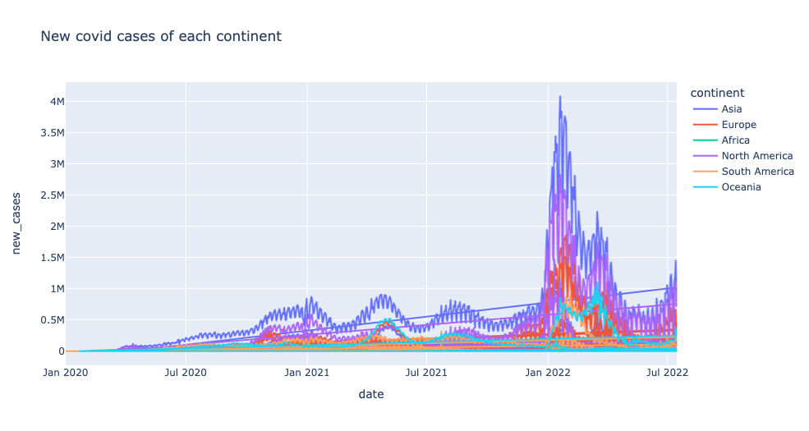

Slide 9

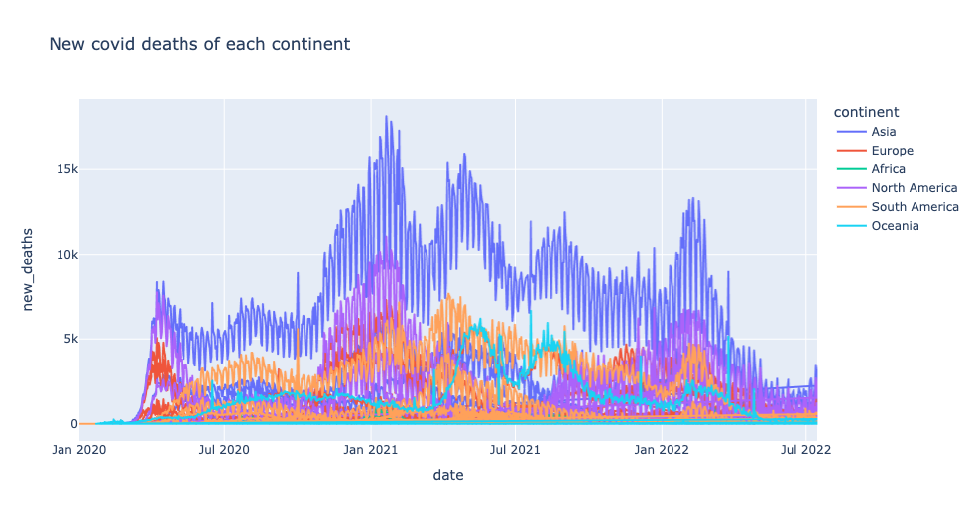

Slide 10
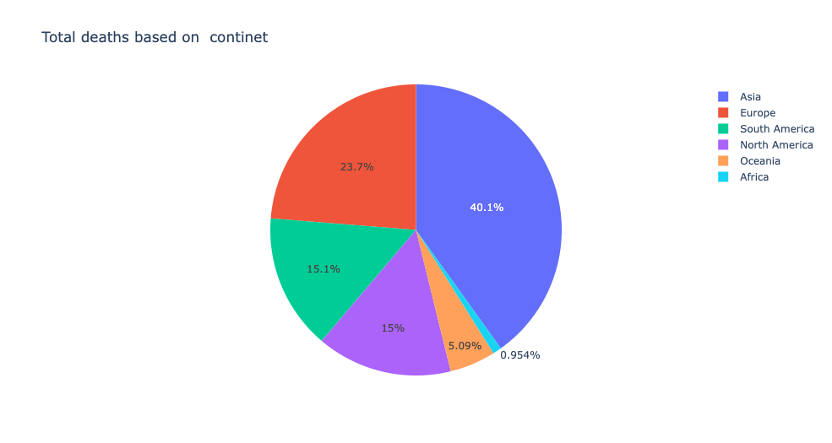
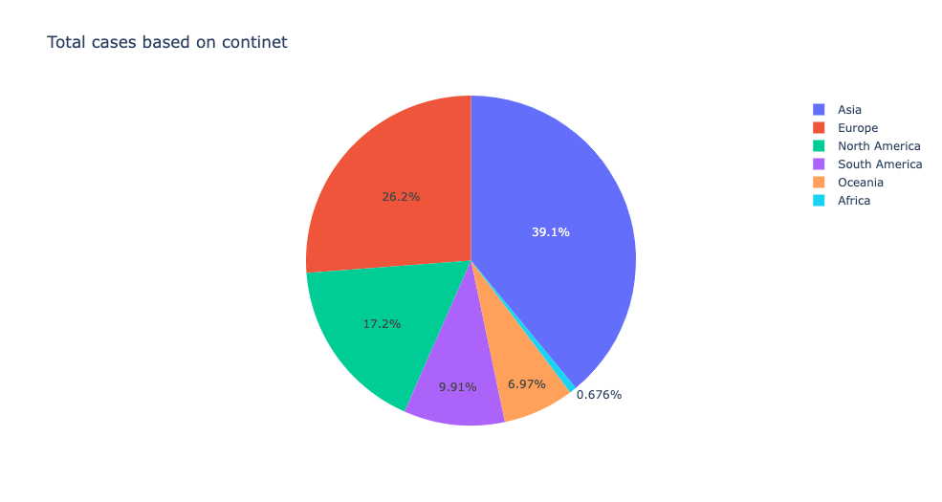

Slide 11
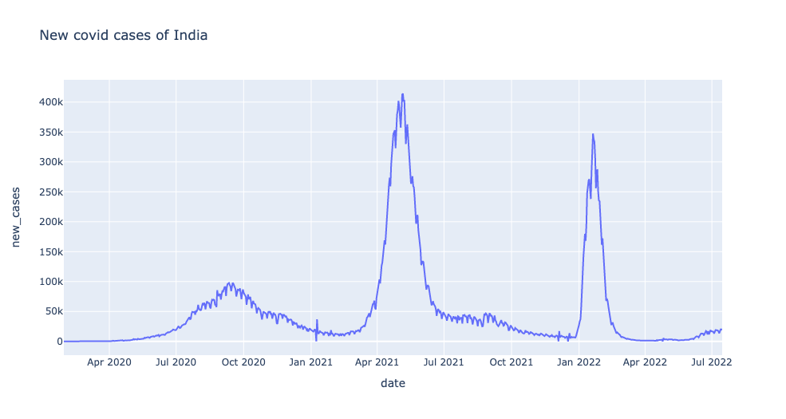
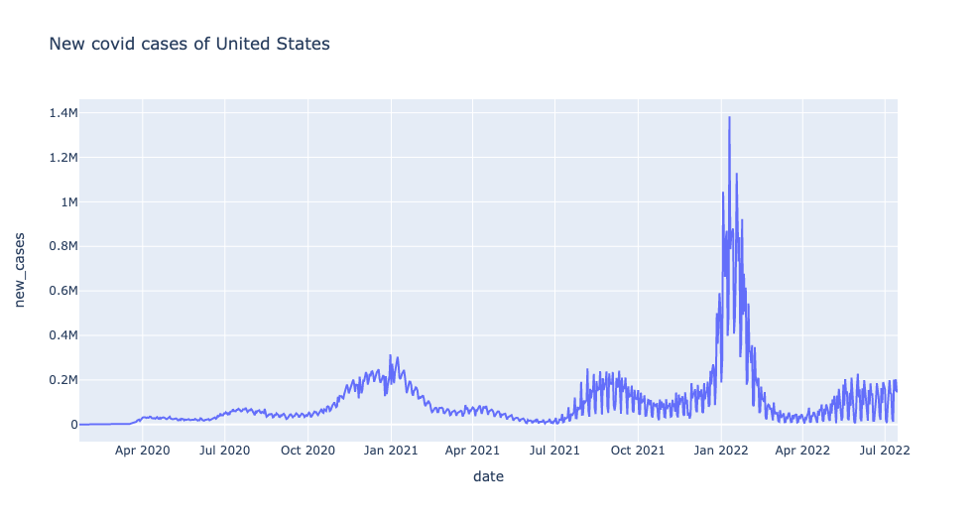

Slide 12

Model Choice
Our data set is a time series data, it has many seasonal changes and its challenging to use a traditional model for the data.
The data demands to pick a model which needs to recognize the peak and fall points for example it needs to automatically understand when there’s fall in the number of cases as vaccines are introduced or the raise of cases when there’s new strain
Based on our data we pursued many models and have picked FB Prophet as a model
Facebook in 2017 has published a paper called, “Forecasting at Scale” which introduced the open-source project Facebook Prophet.

Slide 13

Prophet Introduction
Facebook Prophet is an open-source algorithm for generating time series models that employs some traditional concepts with some modern modifications
It is particularly good at modelling time series that have multiple seasonalities and doesn’t face some of the above drawbacks of other algorithms like LSTM and SARIMAX
Prophet at its core is the sum of three functions of time plus an error term i.e. growth g(t), seasonality s(t), holidays h(t) , and error e(t).

Slide 14
Prophet Functionality
The growth function models the overall trend of the data
The old idea should be familiar to anyone with a basic knowledge of linear and logistic functions. The new idea incorporated into Facebook prophet is that the growth trend can be present at all points in the data or can be altered at what Prophet calls “changepoints”
The growth function has three main parts which has three settings, and they are Linear growth, logistic growth and flat.
The seasonality function is a Fourier Series as a function of time.
The holiday function allows Facebook Prophet to adjust forecasting when a holiday or major event may change the forecast

Slide 15
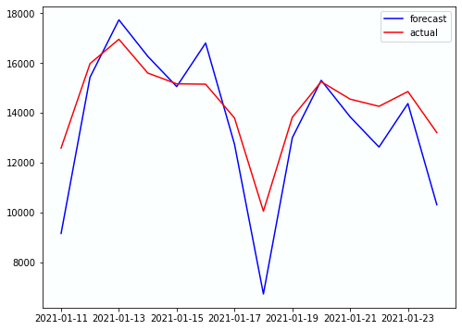
Cases Forecast
You are looking at the forecast & actual cases from January 11th, 2021 to January 23rd, 2021 in India.
Parameters:
changepoint_range = 0.8
changepoint_prior_scale=0.7
growth = 'linear’
holidays_prior_scale = 0
daily_seasonality = True

Slide 16
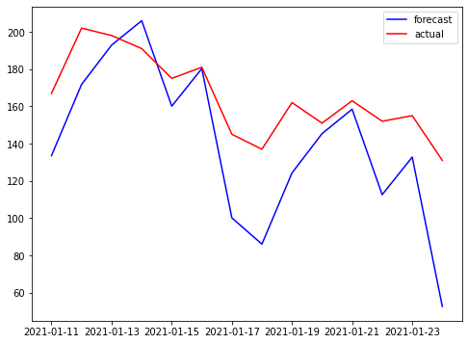
Deaths Forecast
You are looking at the forecast & actual deaths from January 11th, 2021 to January 23rd, 2021 in India.
Parameters:
changepoint_range = 0.5
changepoint_prior_scale=0.25
growth = 'linear’
holidays_prior_scale = 0
daily_seasonality = True

Slide 17
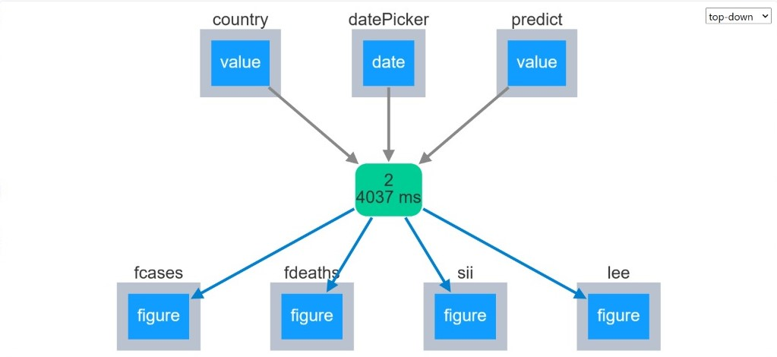
Dashboard Summary
We have used the python libraries like dash, dash’s components & bootstrap components etc. to build the dashboard.
The architecture behind our dashboard is usage of cards.
Pictorial representation of dashboard working can be seen in the below picture.

Slide 18
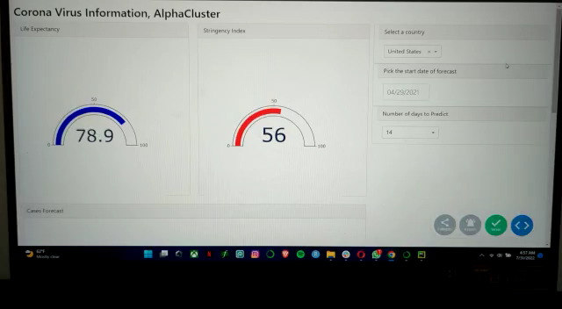
Working of Dashboard

Slide 19
Roles and responsibilities
Each member has brought their ideas to the table
Two ideas has been shortlisted and we have finalized one idea based on the inputs and suggestions of Adithya
After finalizing the idea and dataset we have set our roadmap based on the timeline provided for the course
Good and consistent data will always produce great results and in order to make our data great we have spent ample time by employing few techniques like normalizing few variables, filling the missing values, string manipulation etc..
Data insights and trends are very important for our project hence we have worked out individually to bring our thoughts regarding data.
we have used python as a language and the editor as google collab
we have selected few visualizations to our current presentation.

Slide 20
Individual Contribution in %
Team member | Project idea | Data cleansing | EDA | Model Tuning | WIP 1 | WIP 2 | Dashboards | Final Presentation
Harsha Venkata Sai B | 100 | 95 | 90 | 100 | 100 | 100 | 100 | 95
Manikanta A | 100 | 90 | 95 | 100 | 100 | 85 | 95 | 90
Ratna Sri G | 100 | 85 | 100 | 100 | 90 | 90 | 100 | 100
SaiNath Reddy Y | 100 | 95 | 95 | 100 | 90 | 90 | 95 | 90
Sai Prapulla Seshank A | 100 | 85 | 85 | 100 | 95 | 95 | 95 | 95
Venkata Mahendra C | 100 | 90 | 90 | 100 | 90 | 90 | 90 | 90
Venkata SriKarthik D | 100 | 85 | 90 | 100 | 85 | 90 | 90 | 85
Vishnu A | 100 | 90 | 90 | 100 | 100 | 90 | 90 | 90

Slide 21
Challenges
There are certain fields which require domain expertise and we had tough time understanding them.
The applied prophet model is not conventional model, hence tuning its parameters took more time than the normal algorithms
We have also applied a model called SIER, the SIER model assumes that the members of the compartment are infected but not infectious during the incubation period. Also, there is no guarantee that all infected people are tested and isolated. This group of people is likely to become hidden transmitters in the population. The SIER model with constant parameters cannot be used for long-term simulation.
We have been trying to find the correlation between cases and deaths, but there are certain cases where the death may be resulted from prolonged other health conditions.

Slide 22
Prospects
We are interested in learning more about the relation and trends between the cases, deaths, vaccinations and testings.
We want to add few filters to our dashboards like the lockdown durations and covid restrictions like mask mandates, public gatherings etc.
Add more pictorial metrics that also shows the COVID-19 scenario at global stage.
Implement advanced graphs, If that would make things easy to understand.

Slide 23
References
Forecasting of COVID-19 epidemic size in four high hitting nations (USA, Brazil, India and Russia) by Fb-Prophet machine learning model
A Prophet Model to Forecast Spread of Covid-19 Pandemic
Forecasting the Spread of COVID-19 Pandemic with Prophet
Time series analysis and forecasting of coronavirus disease in Indonesia using ARIMA model and PROPHET

Slide 24
Thank you!

